Slide 1
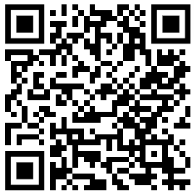

Basismodul Englisch – 5 ECTS (Modulhandbuch, S. 28)
Placement test required. Take test here:
(last test Oct. 17, 2:15pm)
If you have at least 10p in your ENGLISH Abitur or an INTERNATIONAL TEST (e.g. IELTS or TOEFL), you need no placement test.
sz-enghaf@fau.de
Please contact
to have your test / Abitur recognized
if you have ANY other questions

Slide 2


Level 2
Level 3
Level 4
Level 1
Level 0
Then sign up for a course here.
(registration ends Oct. 17, 4:00pm)
sz-enghaf@fau.de
Science Fiction
Academic Discourse
Academic Articles
Advanced Grammar & Vocab
Academic Conferences
American Politics
Reading & Vocabulary
Explaining the World
Intercultural Communication
Presenting
Professional Communication
Music, Movies & Literature
Speaking
Writing
Grammar & Vocabulary
Speaking
Writing
Reading & Listening
Pronunciation
Grammar
Speaking
Writing
Reading & Vocab for Nat. Sci.
Writing & Presenting for Nat. Sci
Editing Scientific Documents
Writing & Presenting Scientific Papers
Writing Papers for Nat. Sci.
Presenting Papers for Nat. Sci.
FOLLOW US ON INSTAGRAM!

